Slide 1
H2-economy opportunities in the LAC region
Alfonso Blanco
OLADE's Executive Secretary
October 29, 2021

Slide 2
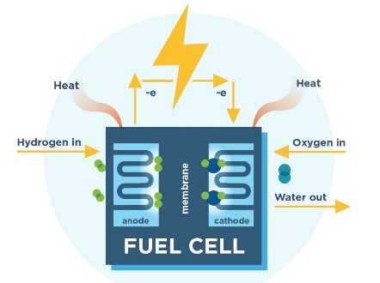
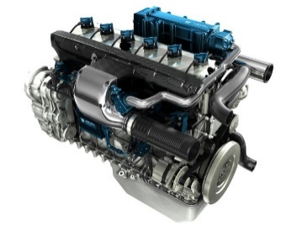
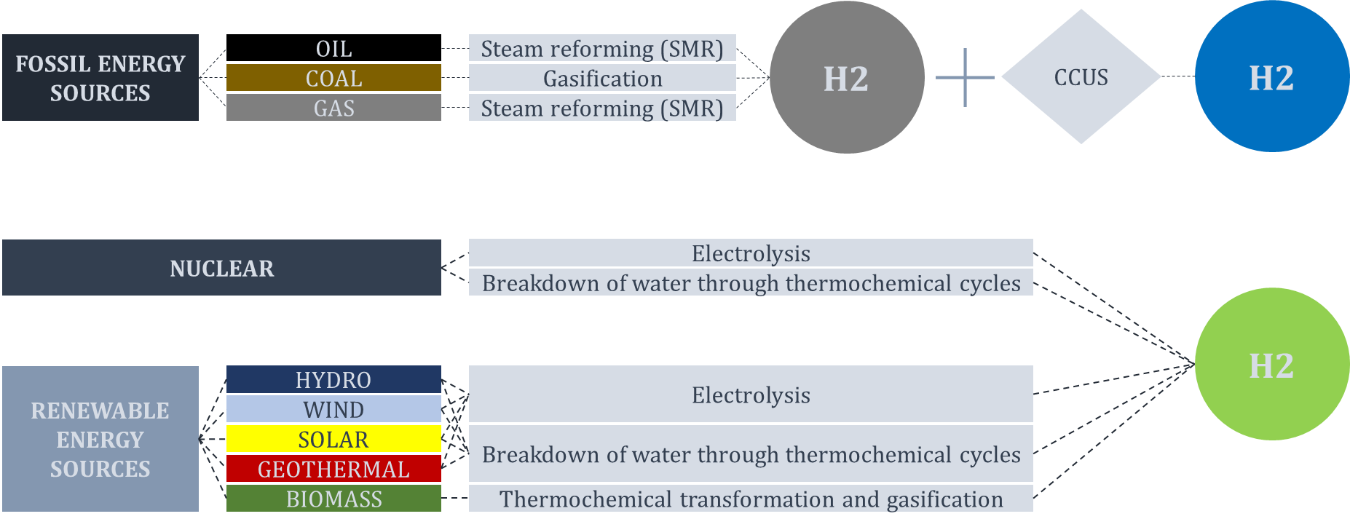
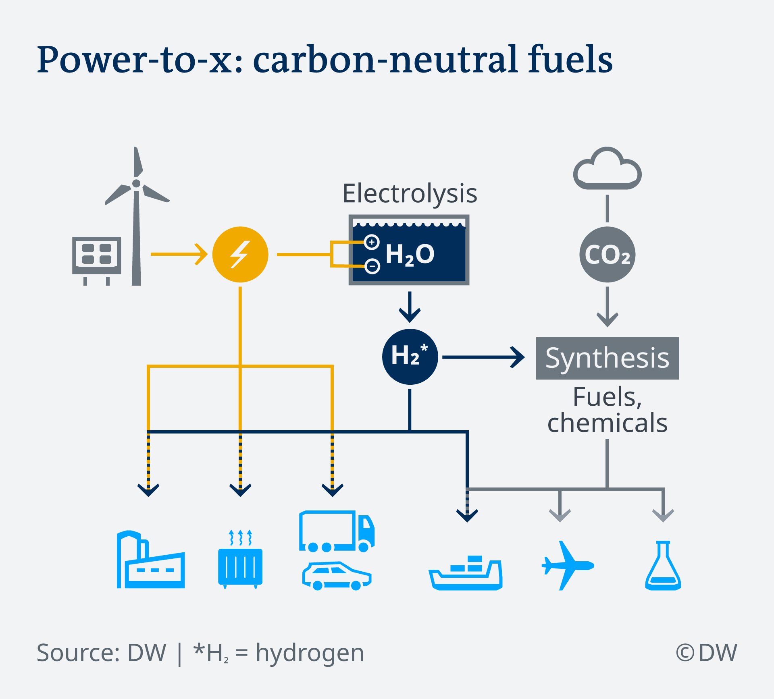
H2-economy, production technologies and energy uses
H2 economy - economy that mainly depends on H2 to supply a major share of a country’s energy and services.
H2 economy can be a reality of different countries if it can be produced at economic and feasible costs, the sources of energy that are needed for its production are local and that its production is done in an environmental-friendly manner.
H2 Energy uses
H2 Production

Slide 3
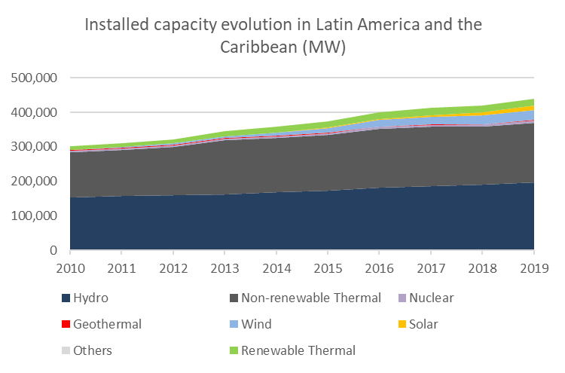
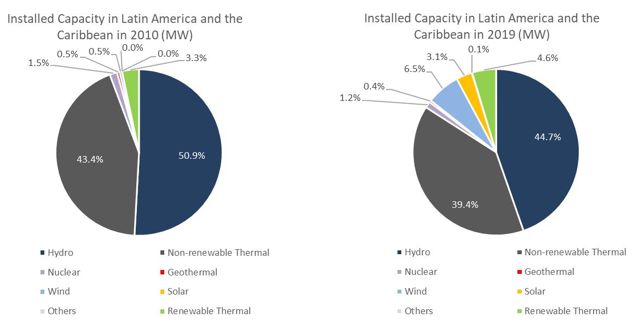
Green H2 opportunities in LAC
The LAC region has an enormous amount of renewable resources such as wind, solar, geothermal, and hydrological. About 59% of its electricity generation matrix is from renewable energy sources.
Source: Own elaboration with SieLAC database.
Countries from the region with high electricity generation from RE sources could focus on developing projects for green H2 production

Slide 4
Green H2 opportunities in LAC
Installed capacity in 2019 (MW)
87% RE
76% RE
99.99% RE
Source: Own elaboration with SieLAC database.
Notes:
Countries with a surplus generation and with a electricity generation matrix that is mainly from renewable sources, could tackle into the Green H2 market. For example, Paraguay, Uruguay or Costa Rica.

Slide 5
The case of Chile
Projects
Chile’s National Green Hydrogen Strategy
The HyEx project intends to use green H2 to make ammonia for Enaex's (a local mining explosives manufacturer) production of ammonium nitrate.
Highly Innovative Fuels (HIF) project in Chile, to produce synthetic fuel using green H2 and CO2 capture.
49.57% RE
Notes:
Chile’s case, in spite of not having the same % of renewable generation as other countries in the región, is currently leading the development of Green H2.

Slide 6
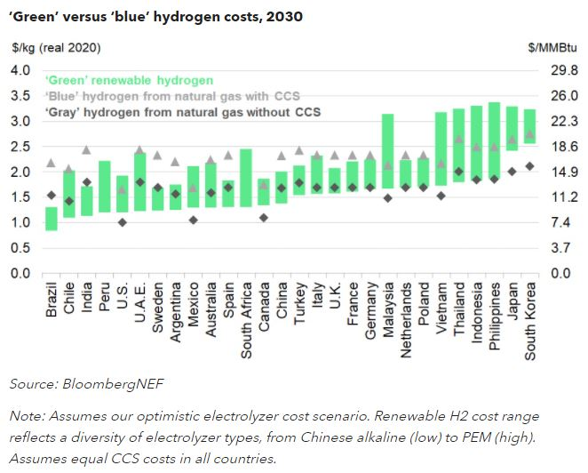
Costs of Gray, Green and Blue H2
Carbon capture, utilization and storage technologies increase the costs of blue hydrogen.
Source: ‘Green’ Hydrogen to Outcompete ‘Blue’ Everywhere by 2030 - https://about.bnef.com/

Slide 7
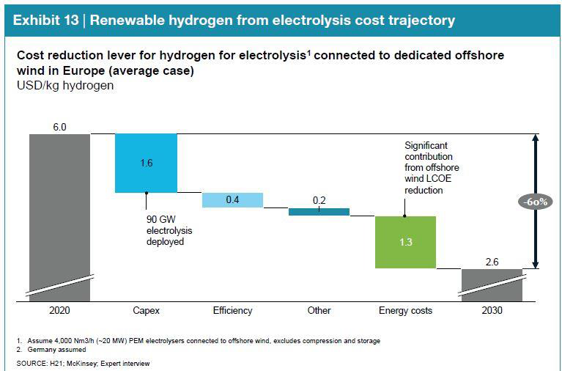
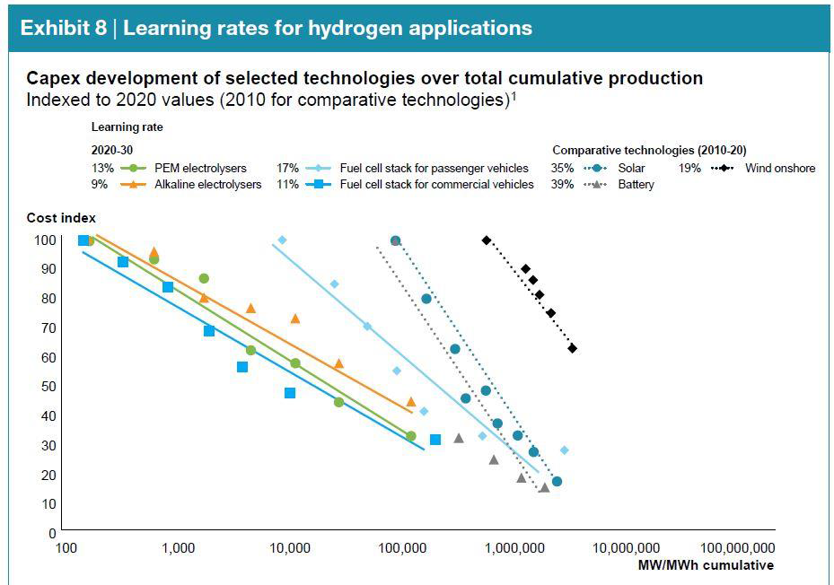
Cost reduction in production and applications

Slide 8
Thank you

